Slide 1
Authorizing Website 3 Homework
Dior D

Slide 2

Logo

Slide 3
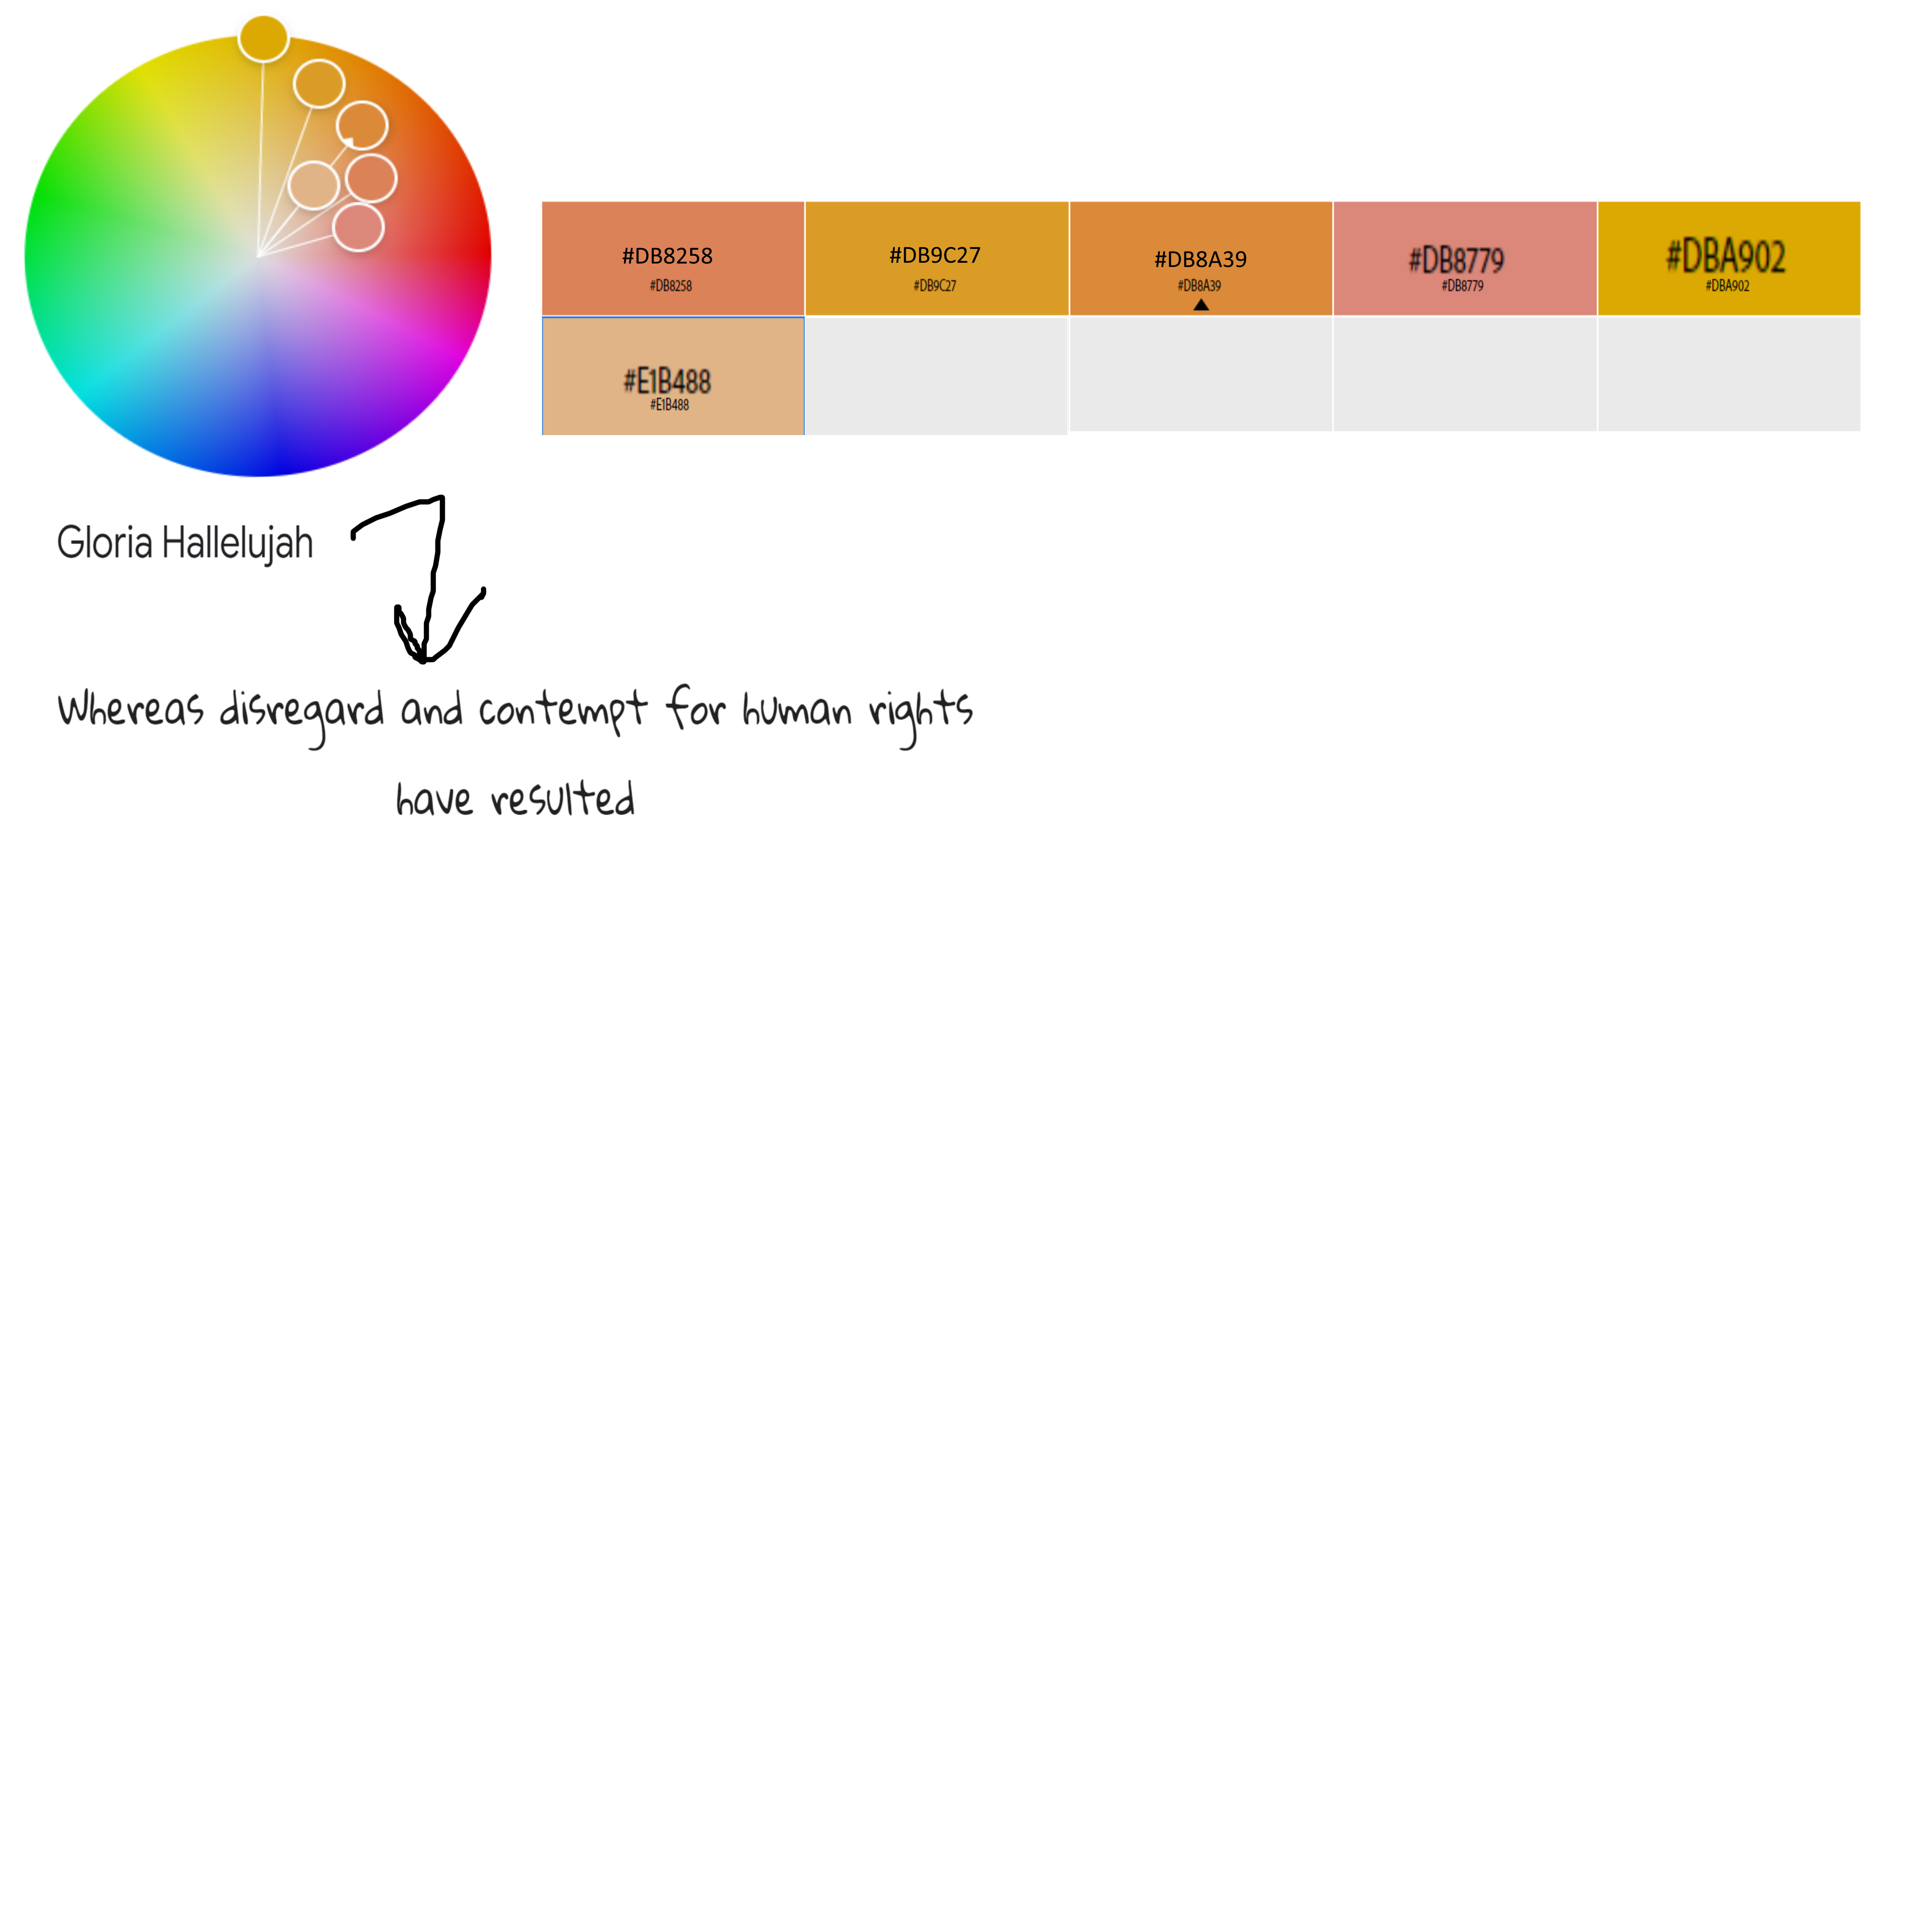
List of colors and fonts

Slide 4
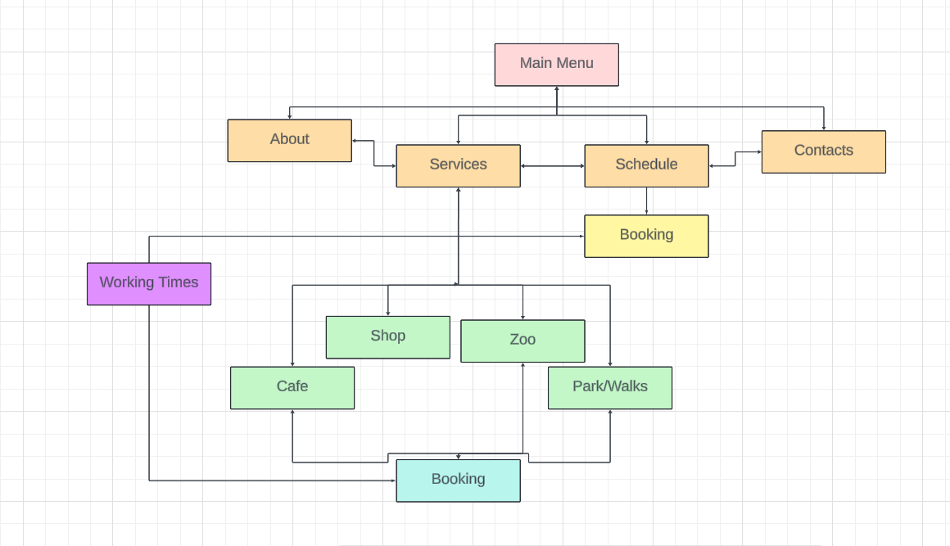
Home page

Slide 5
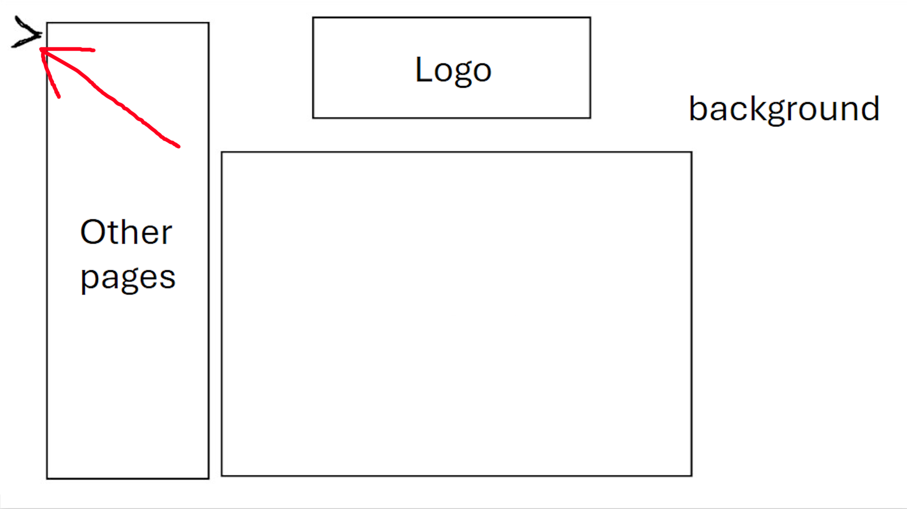
Logo
background
When arrow pressed menu pops up
Other pages
Pictures

Slide 6

Logo
background
Other pages
About Us

Slide 7
Logo
background
Services
Cafe
Zoo
Gift shop
Park
Other pages

Slide 8
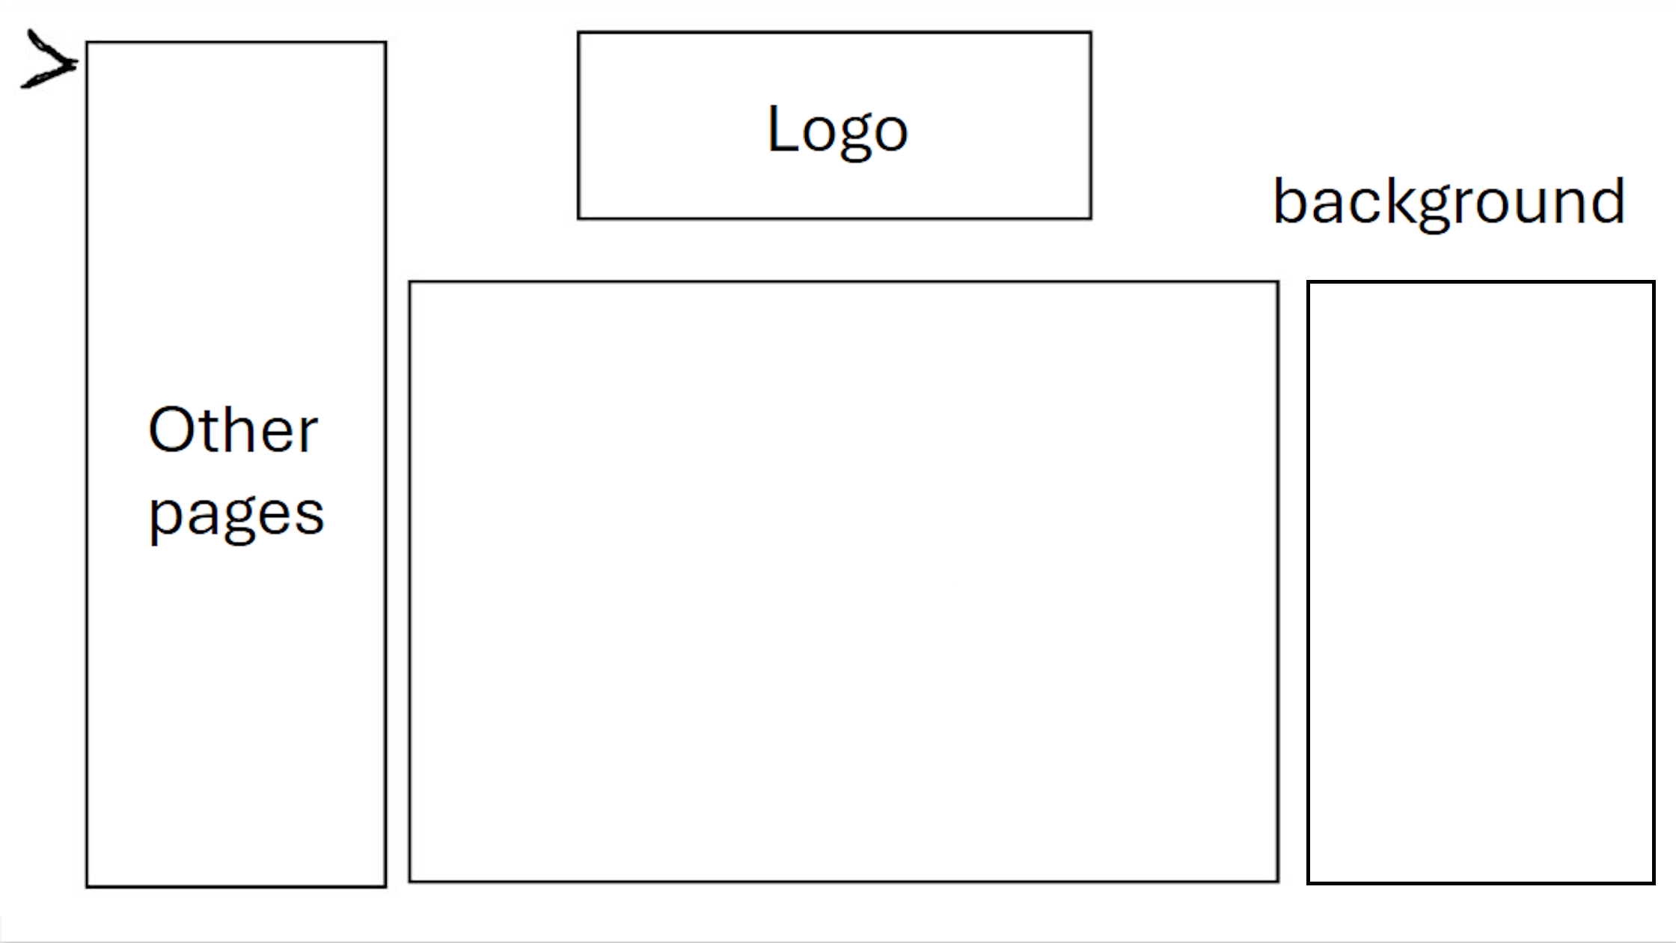
Logo
background
Schedule
Other pages
Mon- Full day
Tue- Full day
Wed- Full day
Thru- Full day
Fri- Full day
Sat- Half day
Sun- Half day
Upcoming holidays:
Booking

Slide 9
Logo
background
Contacts
Support +44
Manager's email @
Job Application @
Status : Available/Busy
Other pages

Slide 10
Logo
Booking
Public Visit
Weekend-
Adult- £
Child(under)- £
Weekday
Adult- £
Child(under)- £
Private event
Weekend-
Adult- £
Child(under)- £
Weekday
Adult- £
Child(under)- £
background
Other pages

Slide 11
Logo
background
Working Times
Full day: Holiday:
??am-??pm CLOSED
Half day:
??pm-??pm
Other pages

Slide 12
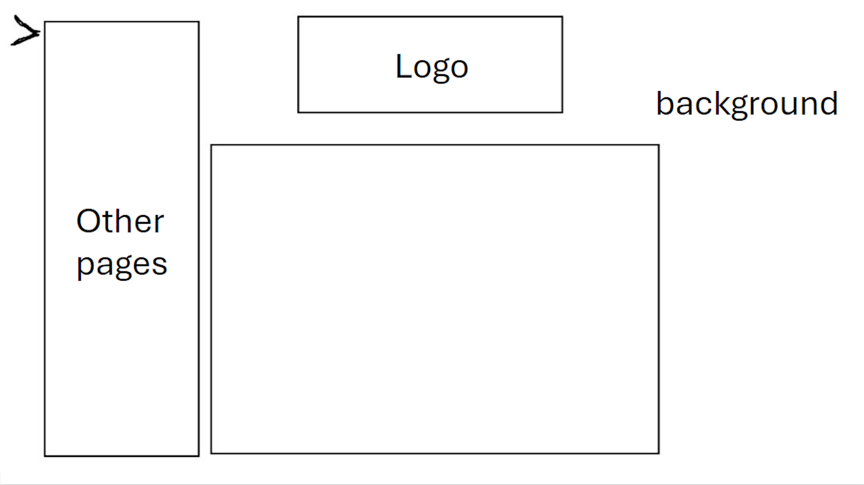
Cafe
(Menu)

Slide 13
Logo
background
Merch(Shop)
Other pages
Plushie £
Hoodie £
T-Shirt £
Bracelet £

Slide 14
Interactive Zoo
Animals we have
(animals)
Bring your own pet (just to the zoo)
£

Slide 15
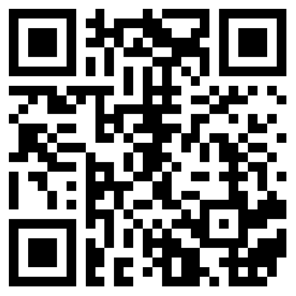
Park
Scan all these QR codes around the park to get a prize (go to reception to receive)
(Different clues of where the QR codes could be)

Slide 16
Logo
Booking
Public Visit
Weekend-
Adult- £
Child(under)- £
Weekday
Adult- £
Child(under)- £
Private event
Weekend-
Adult- £
Child(under)- £
Weekday
Adult- £
Child(under)- £
background
Other pages

